Slide 1
Big Mountain Optimum Ticket Price Model
Biman Mondal

Slide 2
Problem Statement
Big Mountain Resort
350,000 visitors each season
Boasts 105 trails
Longest run: 3.3 mi Hellfire trail
Vertical drop: 2,353 ft
Recent installation of additional chairlift
Operating costs increased by $1.5Mil
Current ticket prices $81/day
Highest ski resort ticket price in MT

Slide 3
Problem Statement Cont.
Determine current market ticket price value of Big Mountain resort
How much room is available to increase the ticket to?
Investigate how Big Mountain can maximize capitalizing on its facilities.
Identify cost cutting to increase revenue further

Slide 4
Key Findings & Recommendation
Utilized a dataset of all ski resorts in the US to create a price model
Model has identified key features ‘fastQuads’, ‘Runs’, ‘Snow Making’, and ‘Vertical Drop’
The model places Big Mountain within the $100/ticket range with a $10 mean absolute error
Increase ticket price to $90 since it’s lower end of price error
Projected revenue increase: 15Mil (~11%)
Ticket prices can be increased in phased increments
Other revenue increasing measures
Increase vertical drop by 150 feet and increase chair frequency by 1
Projected revenue increase $3.4Mil
Reduce number of runs to decrease operational cost
Comparing to other resorts, Big Mountain is already has one of the highest skiable terrain area and one of the largest number of runs.
Reducing 2 runs, has the same effect on ticket price as closing 3.

Slide 5
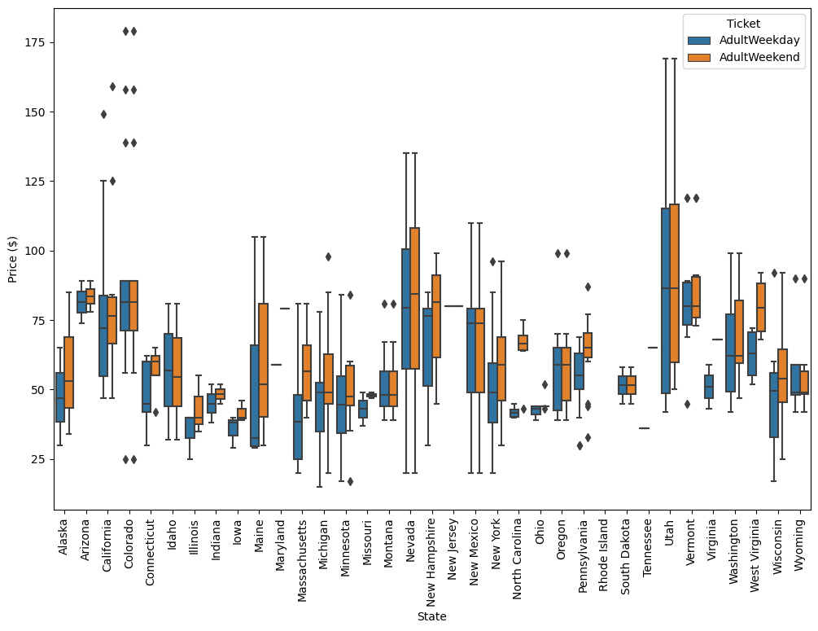
Modeling Analysis
Single dataset was provided by Alesha Eisen, the Database Manager.
Missing data replaced to produce an usable dataset

Slide 6
Modeling Analysis Cont.
Two models: linear regression and random forest model were created of the dataset.
Three performance metrics used to measure model “goodness”
R2 (r-squared), mean absolute error (MAE), and mean square error (MSE)
Random forest model had lower MAE than the linear regression model
$11.8 vs. $9.5
Based on error results, random forest model was chosen to continue with the analysis

Slide 7
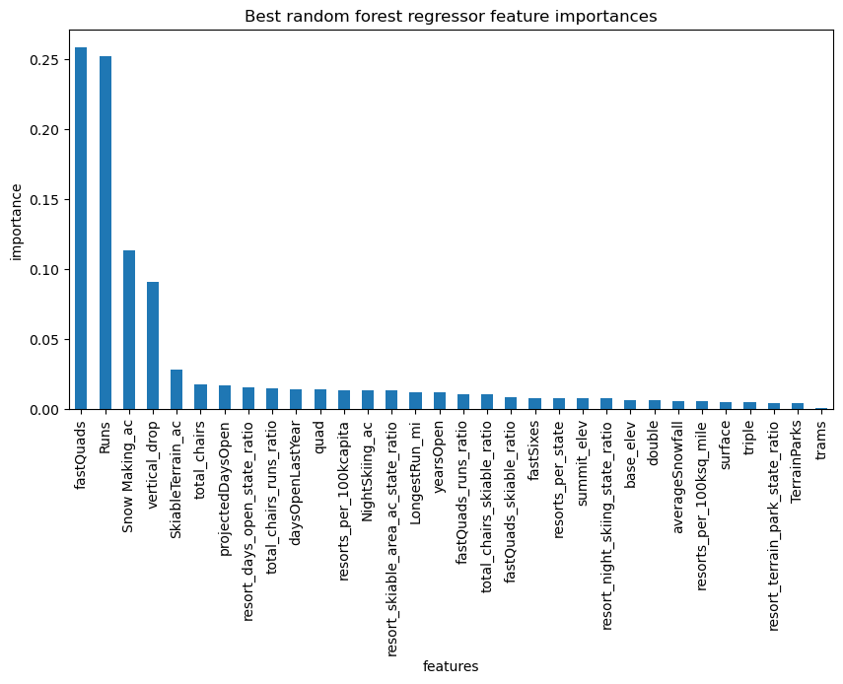
Modeling Results
Random forest model identifies which parameters are most important to predicting the ticket price
The number of fastQuads and runs showed the best correlation to ticket price

Slide 8
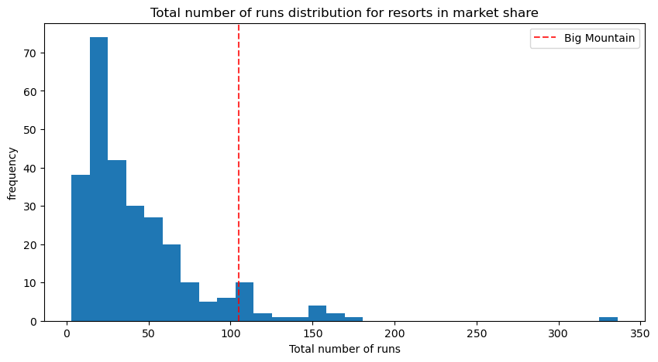
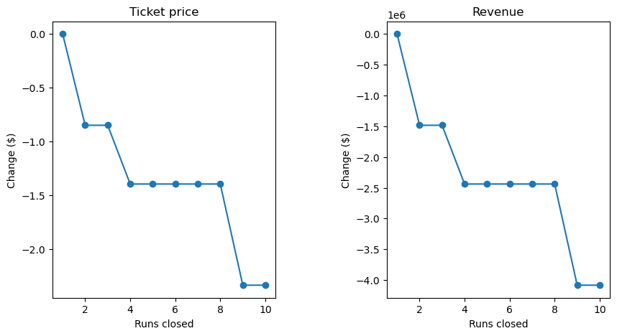
Modeling Results Cont.
The total amount of runs for Big Mountain is already on the high end
Reducing a few runs would decrease revenue but also may decrease an unknown operational cost

Slide 9
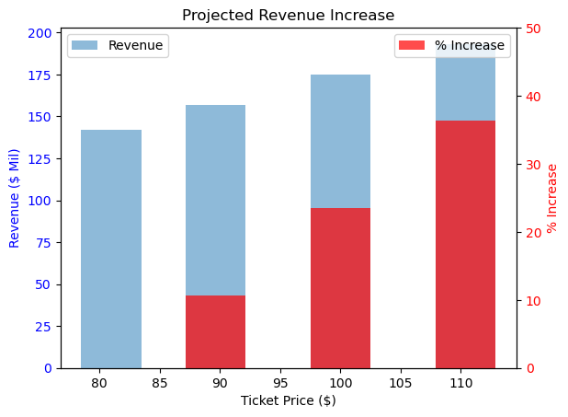
Summary
Based on model estimate, the ticket price should be ~$100 ± $10
Charging ticket price of $100 will increase revenue $141.8Mil to $175Mil (~33%)
Recommend phased increase to higher ticket price starting with $90 (11% revenue increase)
Increase vertical drop by 150 feet and increase chair frequency by 1 to see further ticket price growth potential
Recommend a few low frequency trails to close

